Slide 1
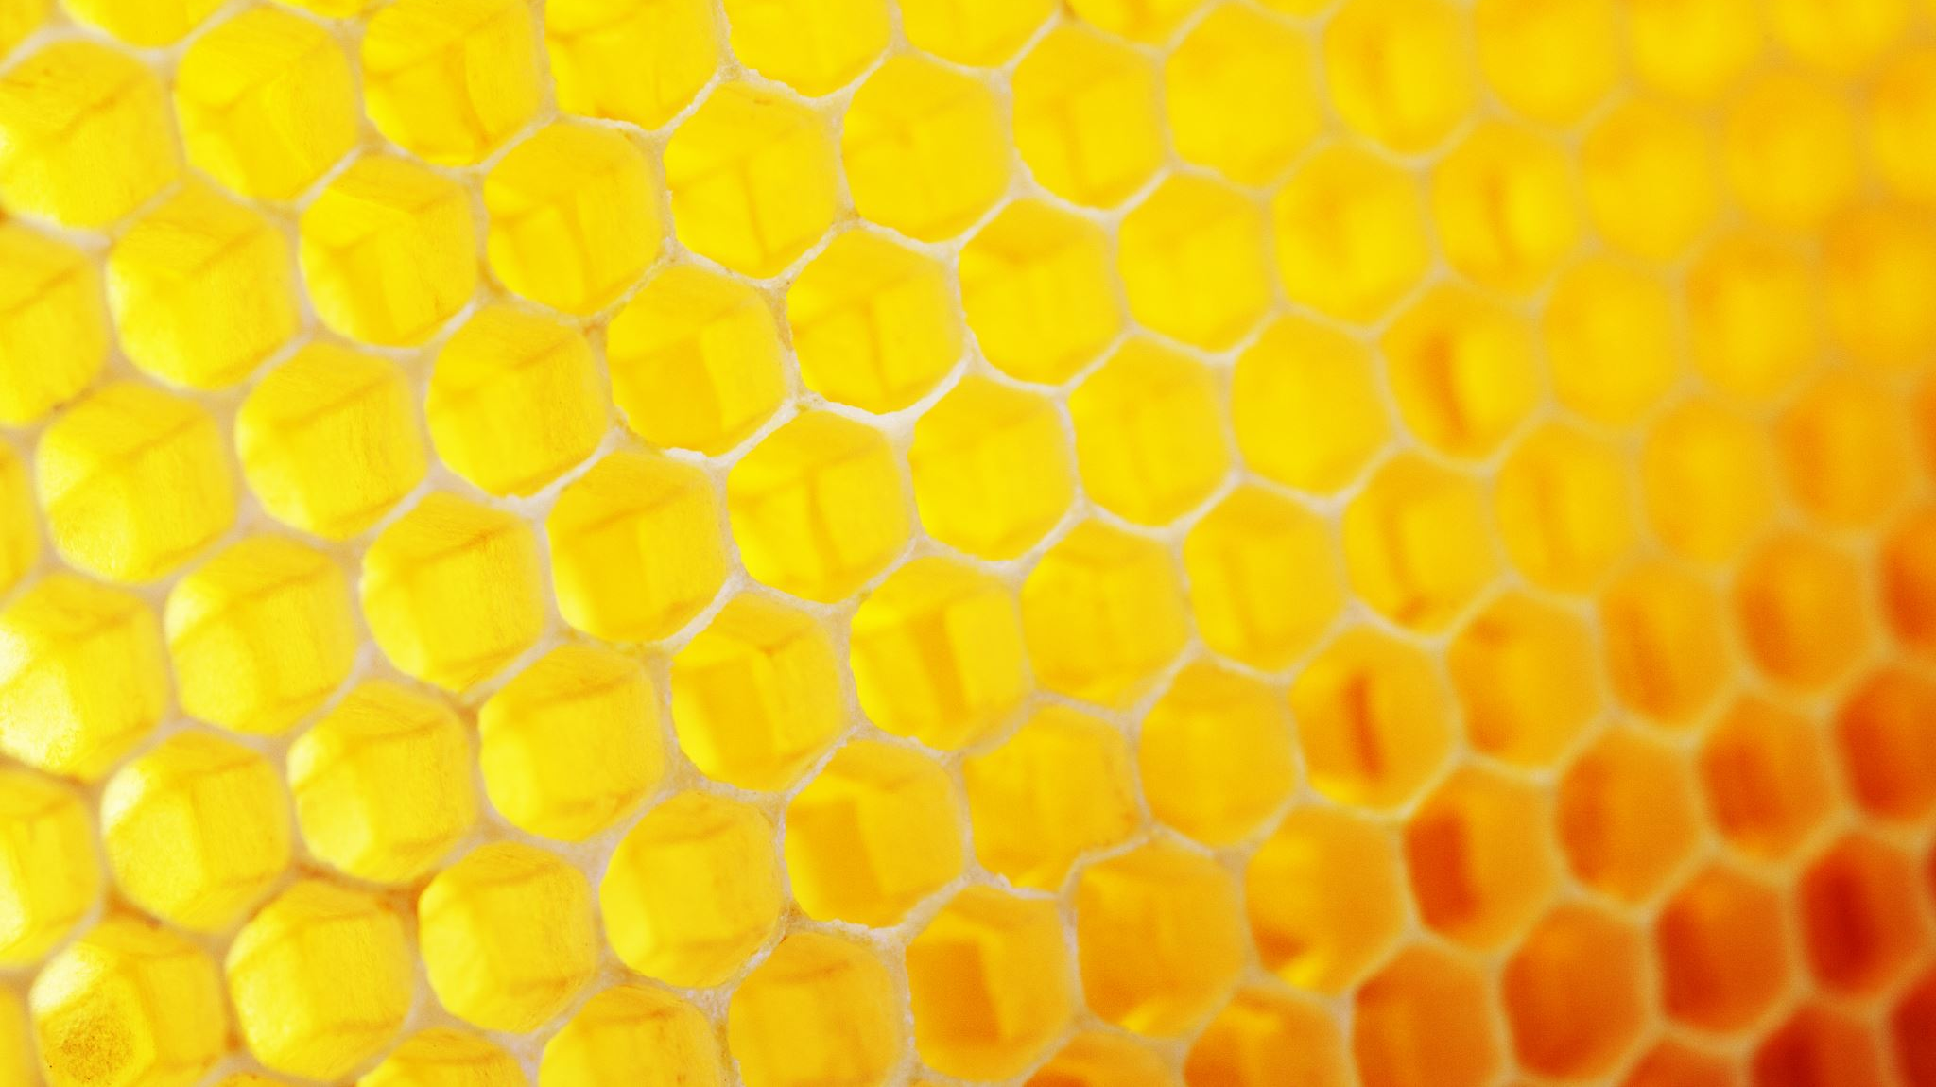
Science Projects
2019-2020
Second Grade

Slide 2
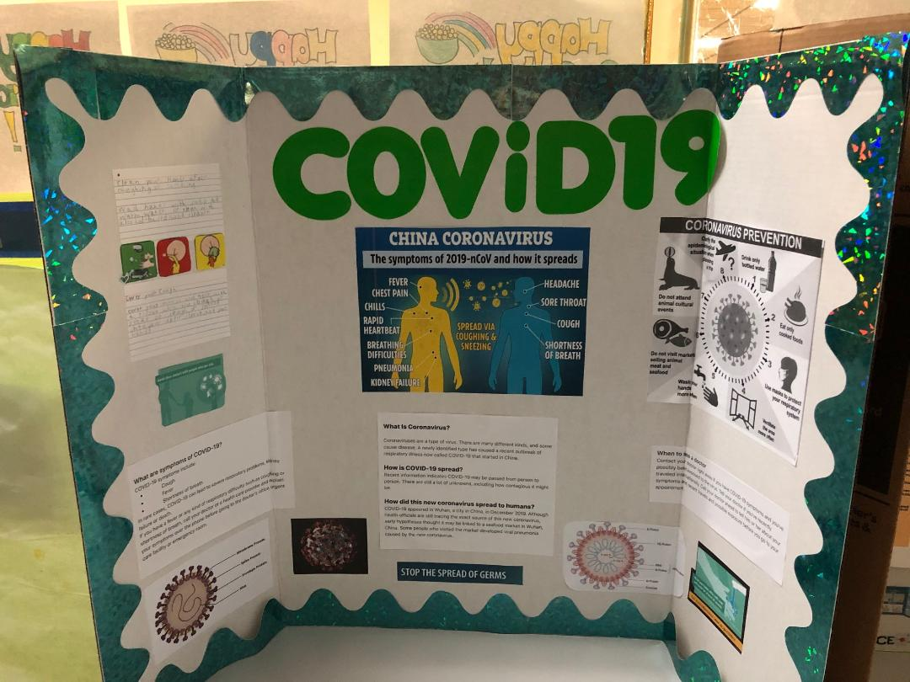
Brianm Ballester

Slide 3
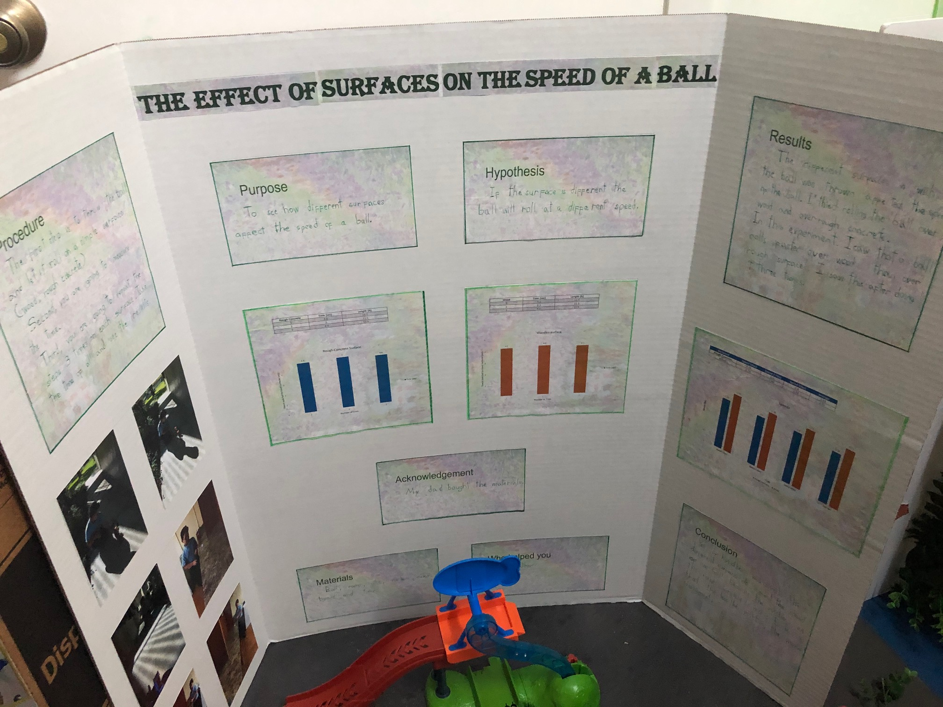
Jonathan
Benitez

Slide 4
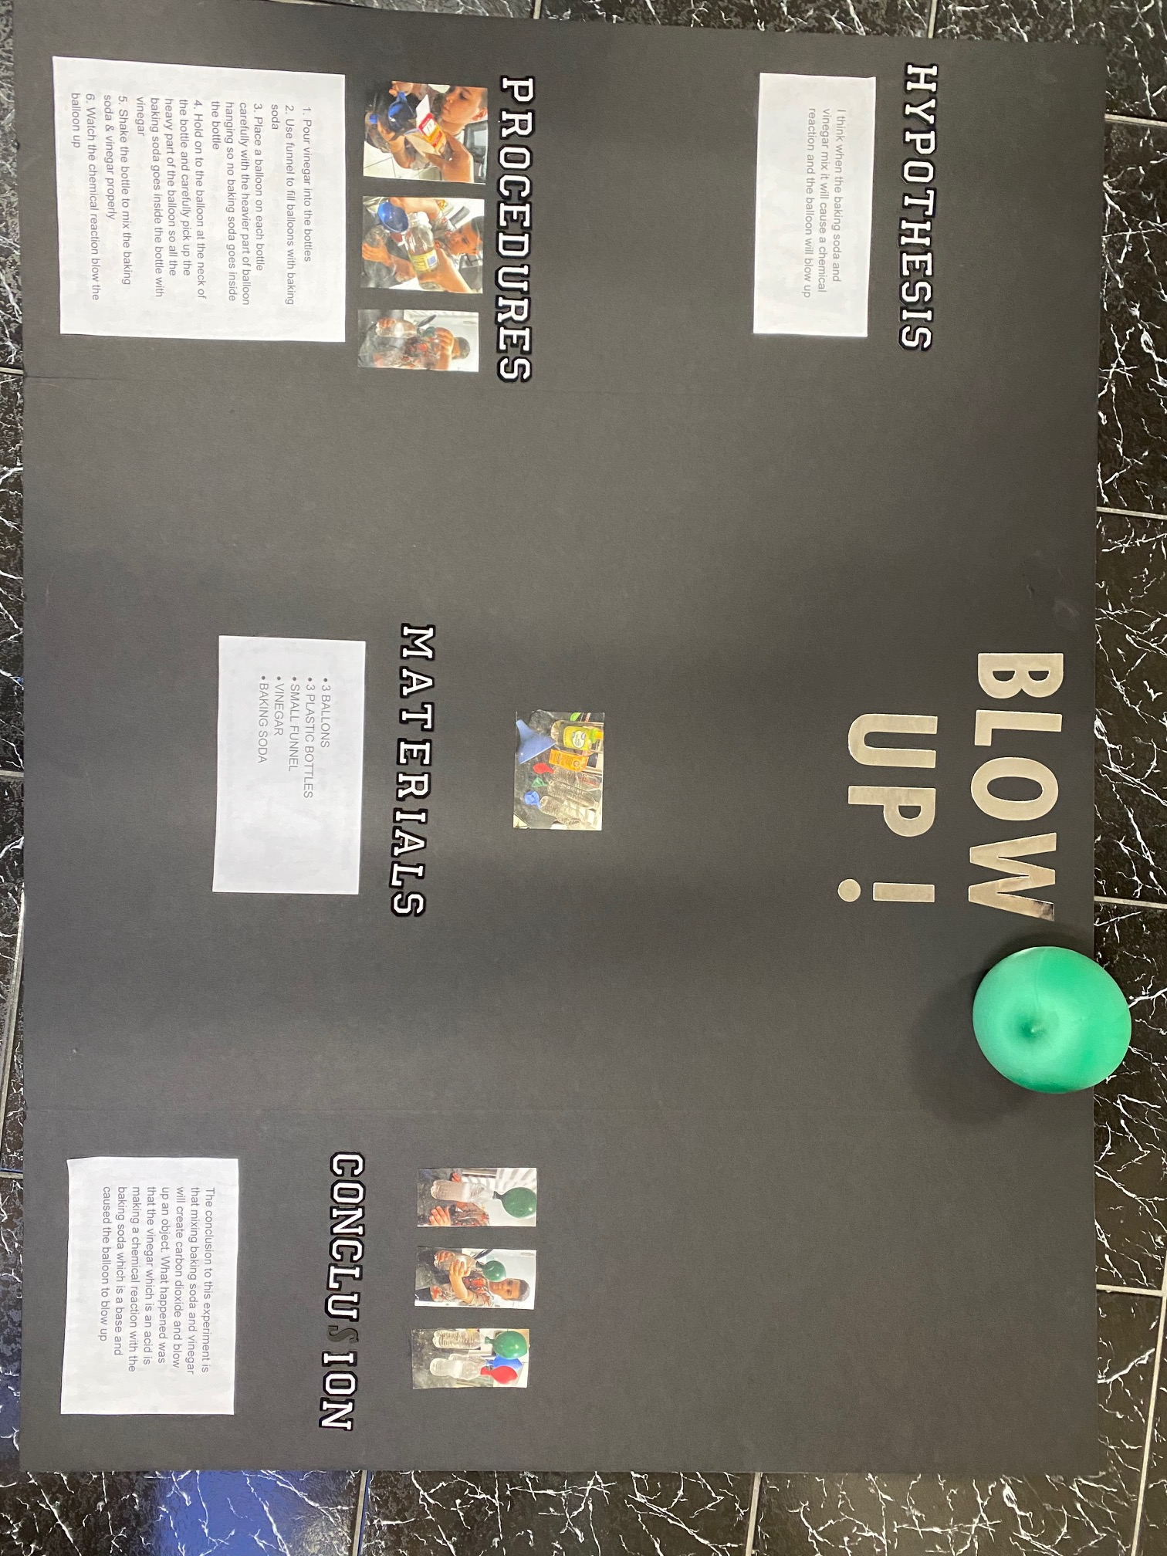
Joseph Capo

Slide 5
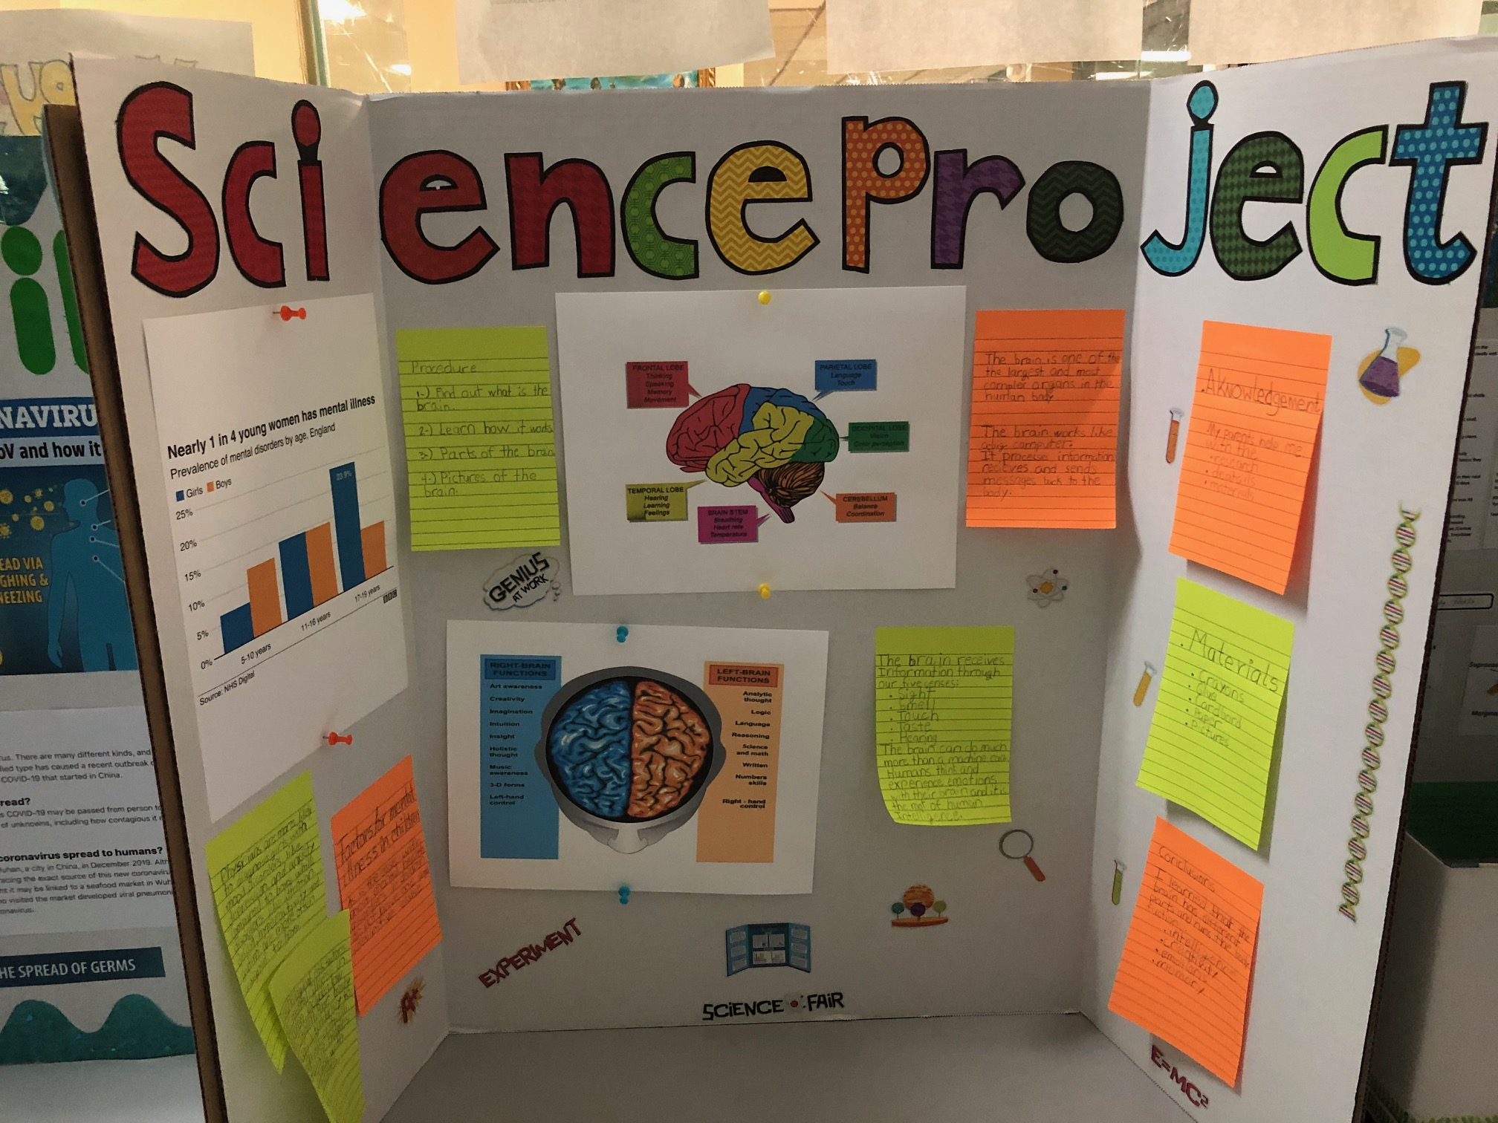
Dario
Del Toro

Slide 6
Jonathan benitez

Slide 7
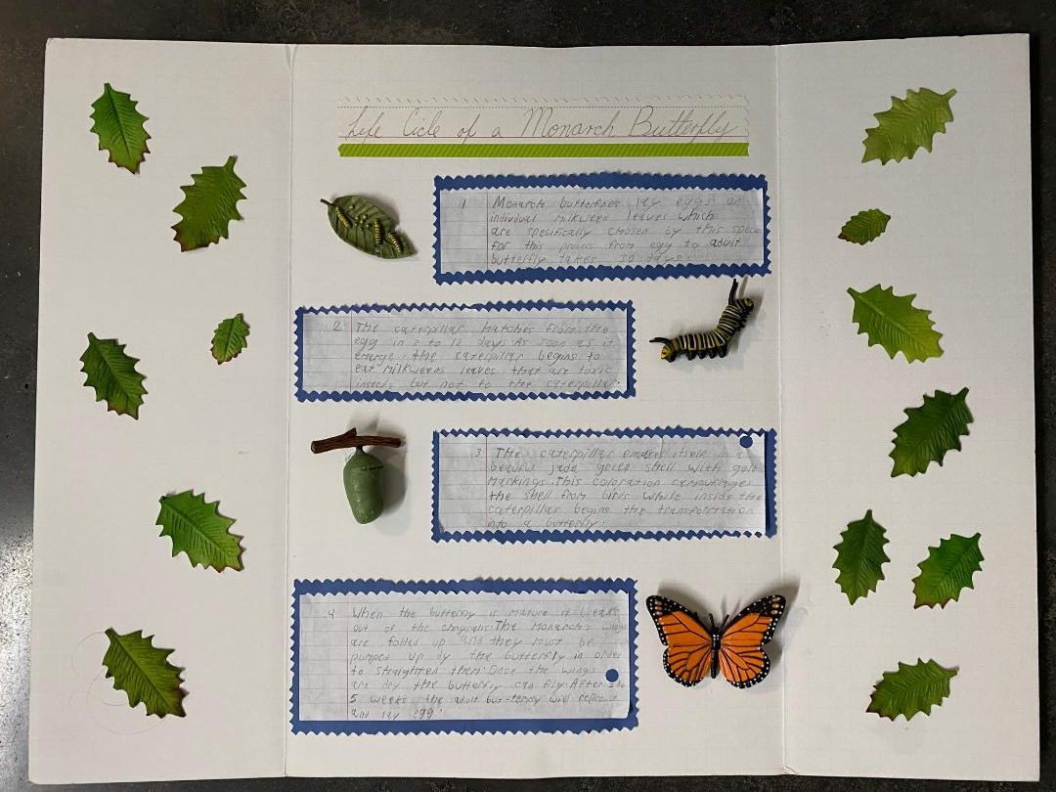
Maya Diaz

Slide 8
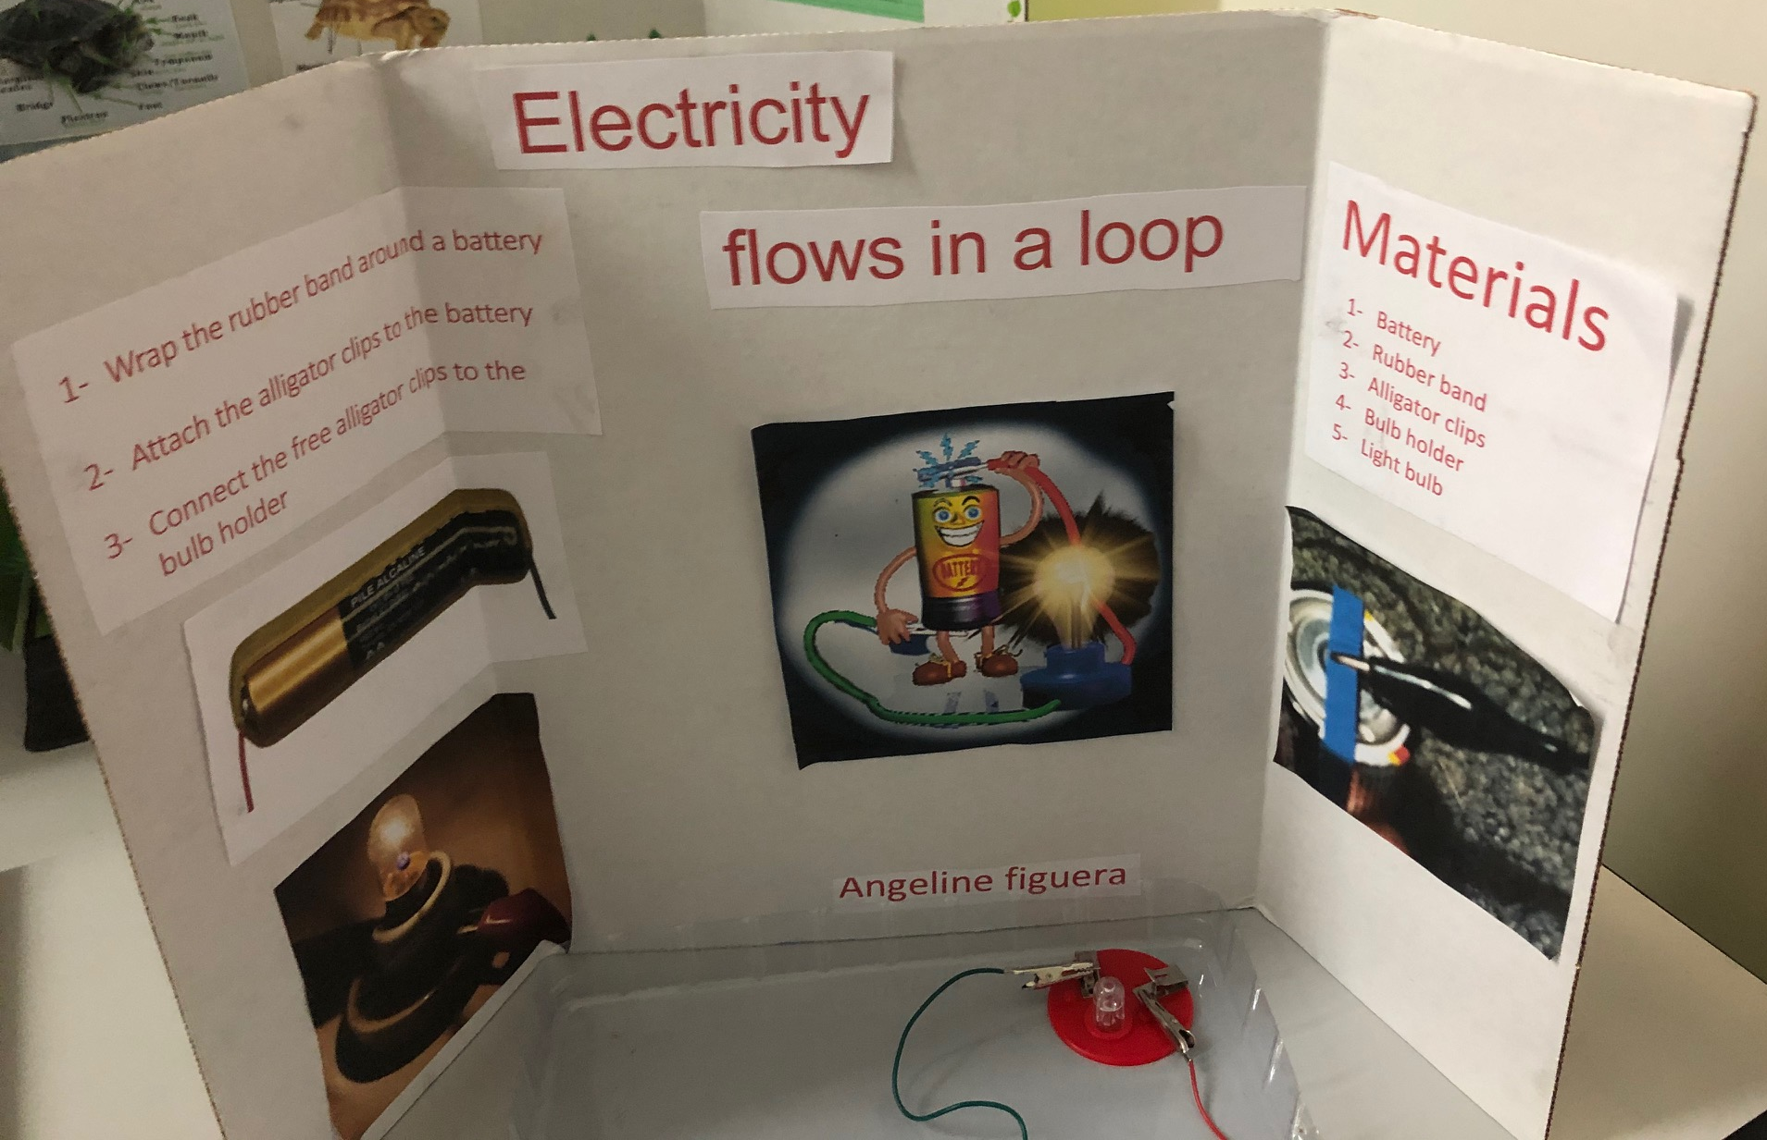
Angeline Figuera

Slide 9
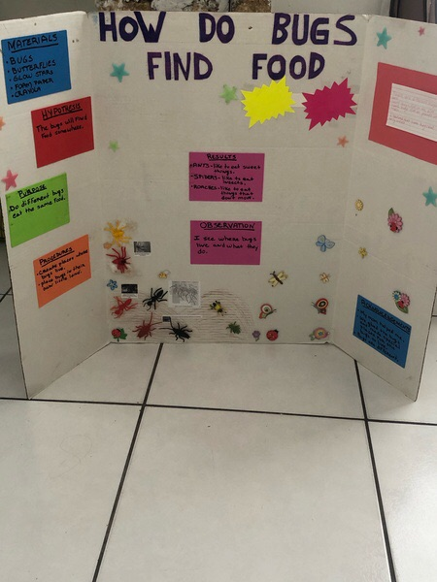
Kendry Hernandez

Slide 10
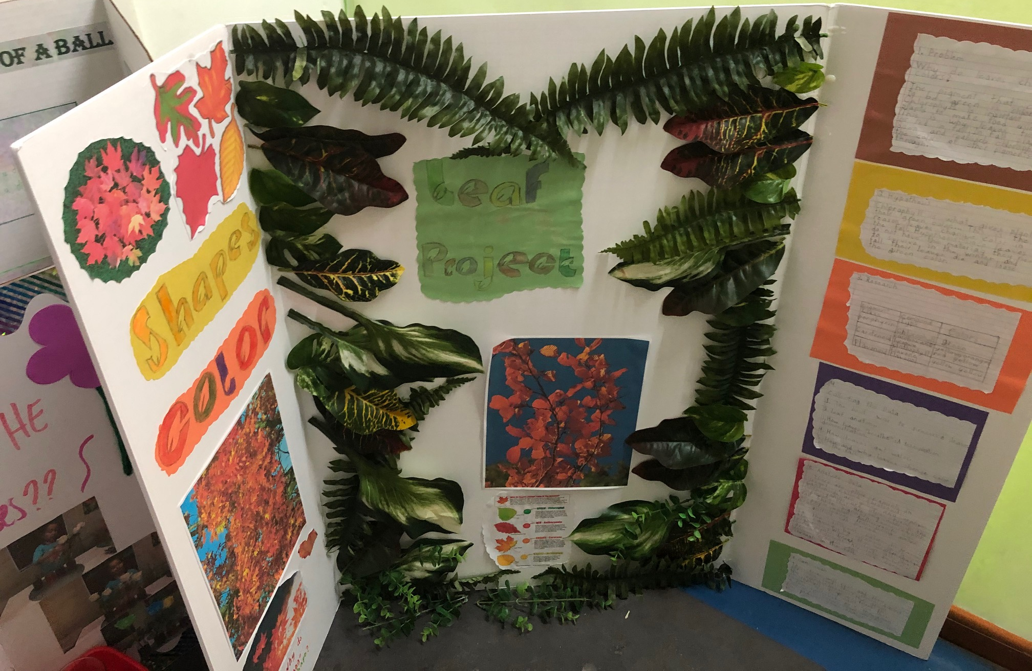
Jailyne Hidalgo

Slide 11
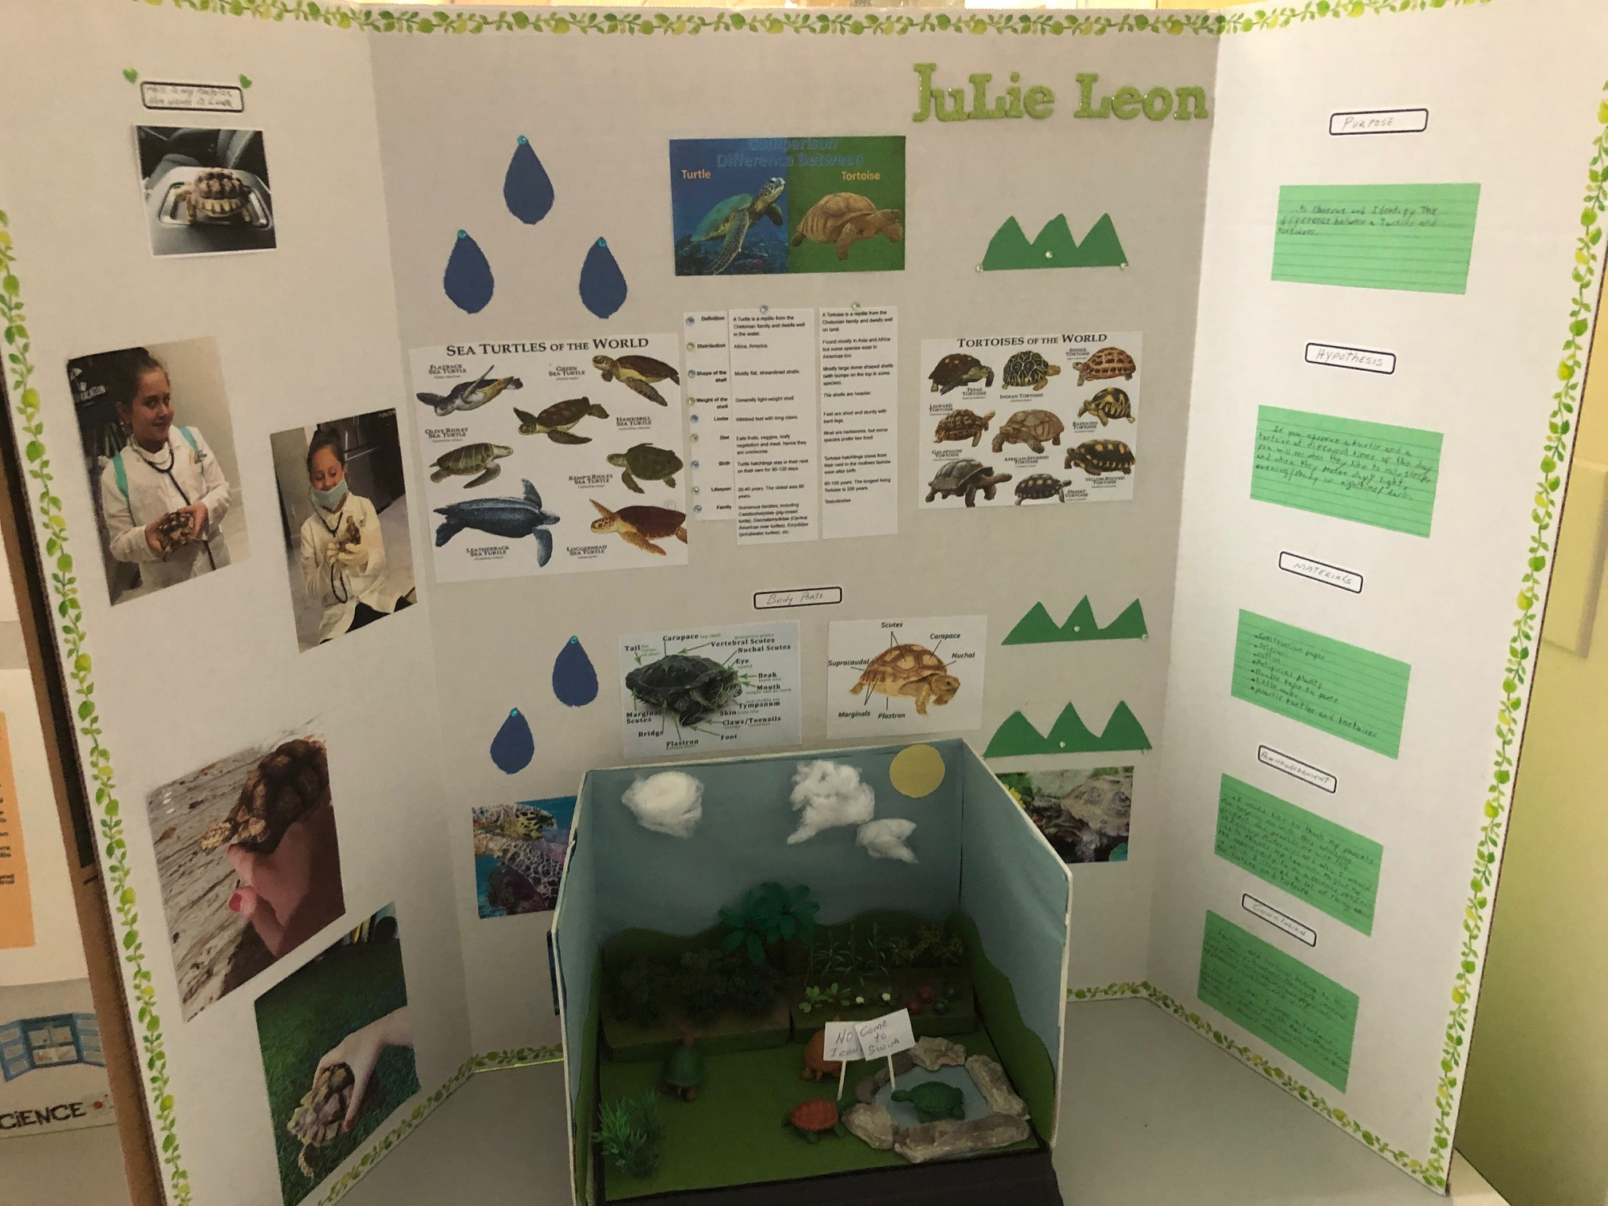
Julie Leon Navarrete

Slide 12
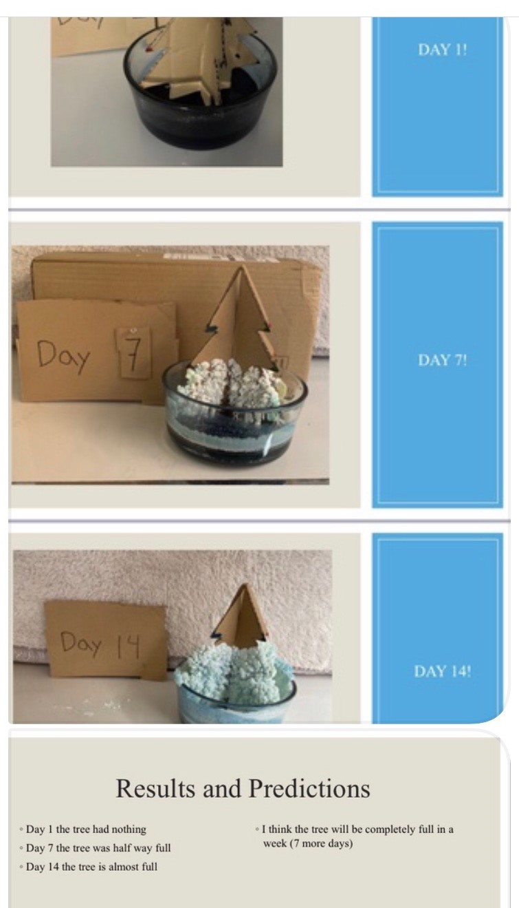


Slide 13
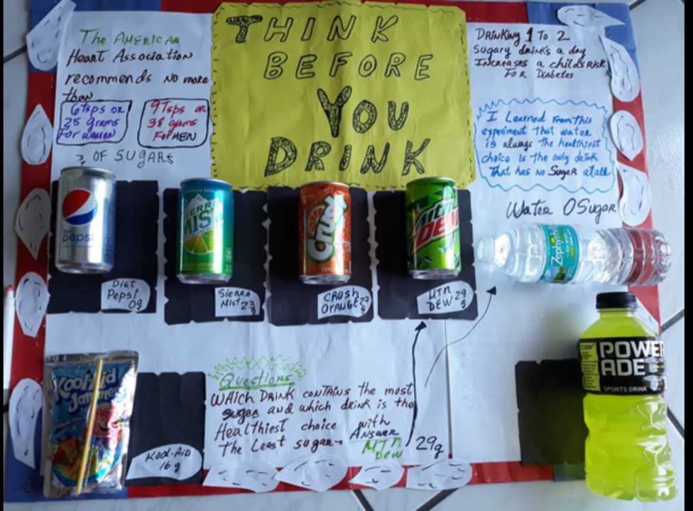
Ryan Ortega

Slide 14
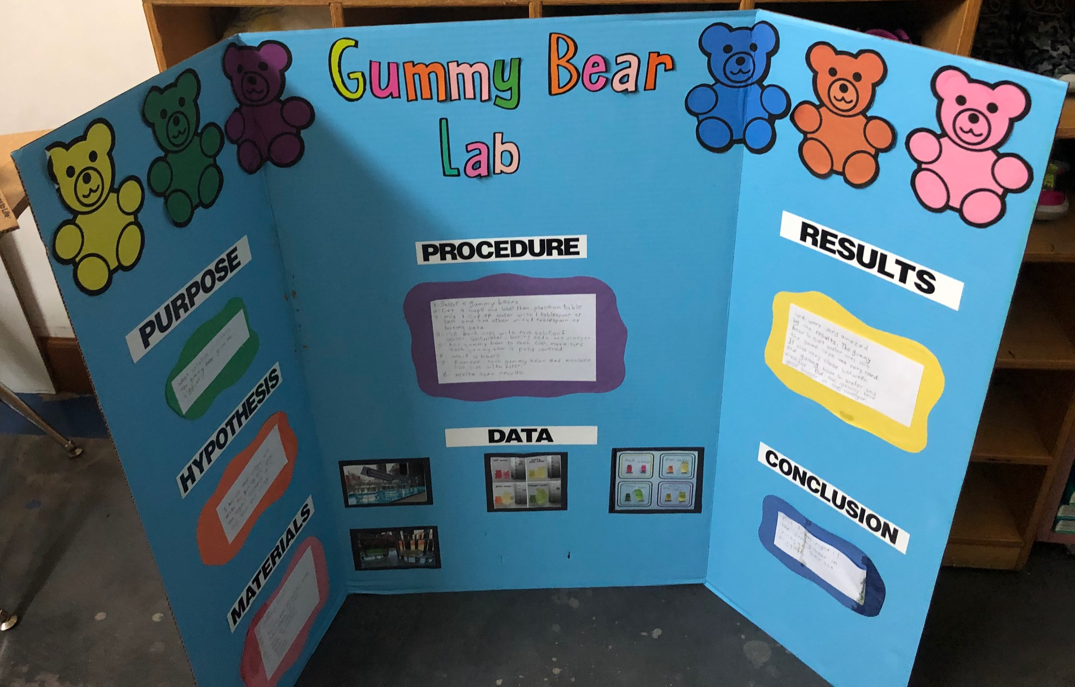
Evelyn Padron

Slide 15
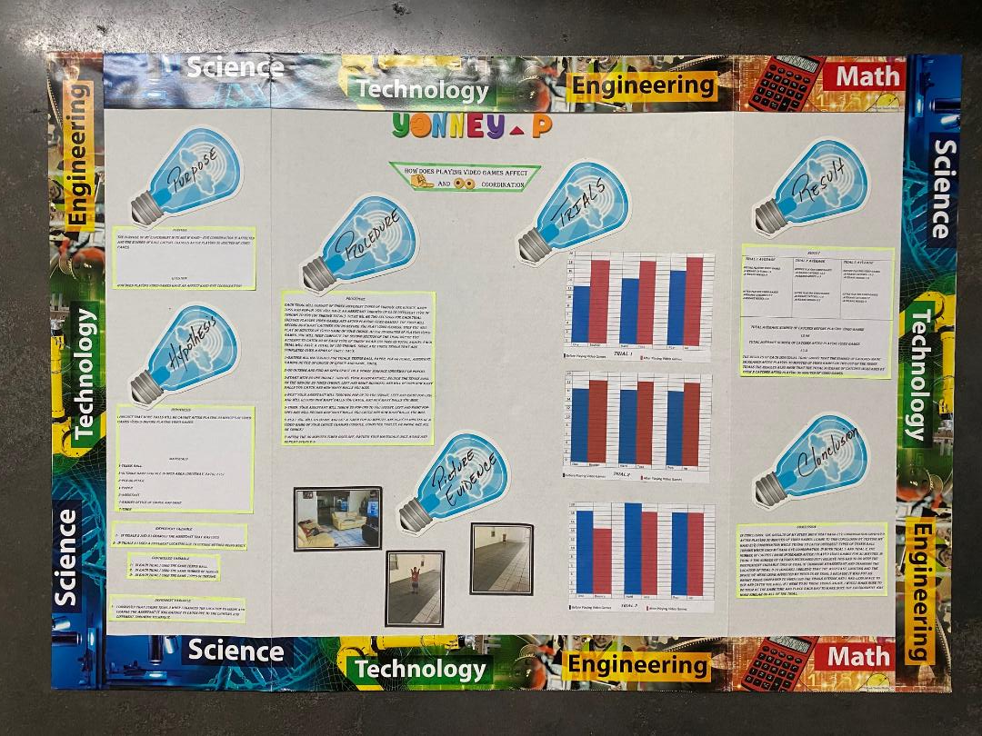
Yonney
Puerto

Slide 16
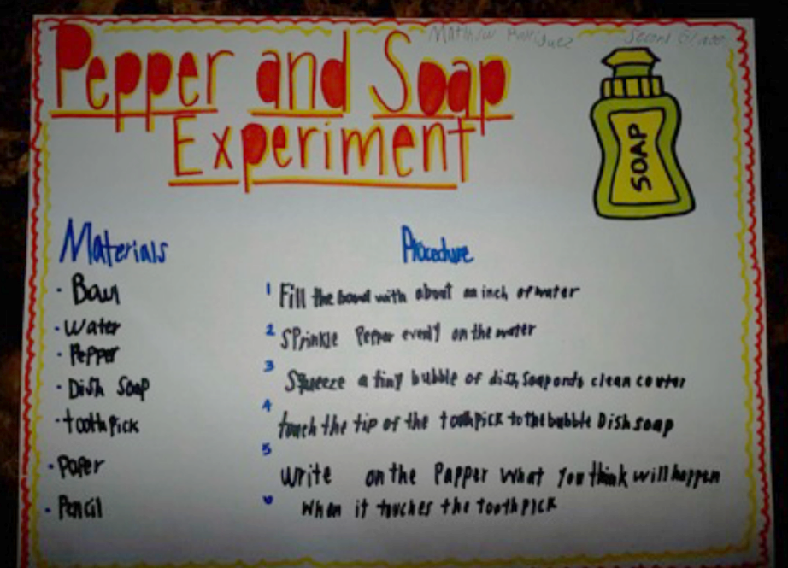
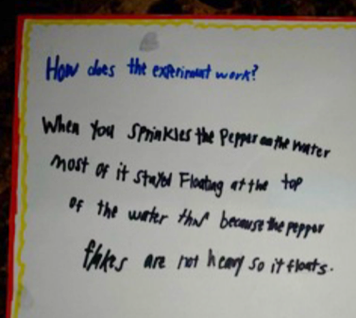
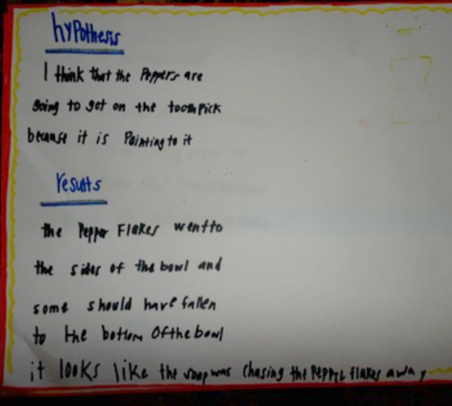
Matthew Rodriguez

Slide 17
Science Fair Projects
Third Grade 2019 - 2020

Slide 18
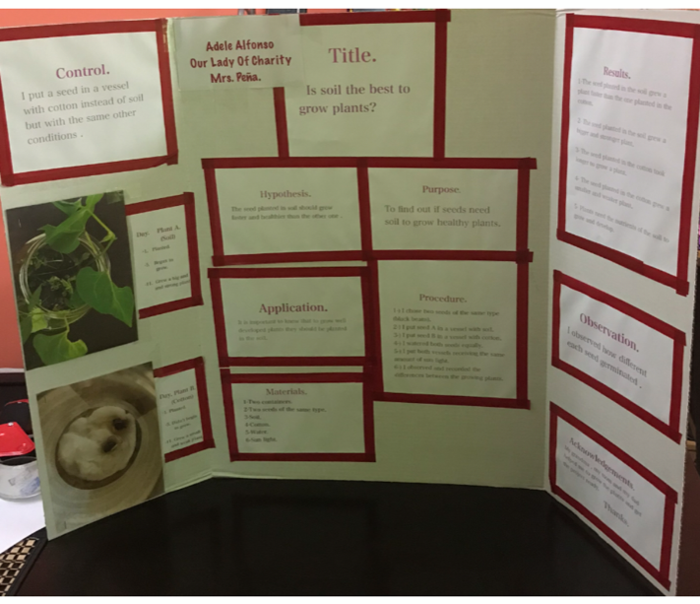
Anabel Alfonso

Slide 19
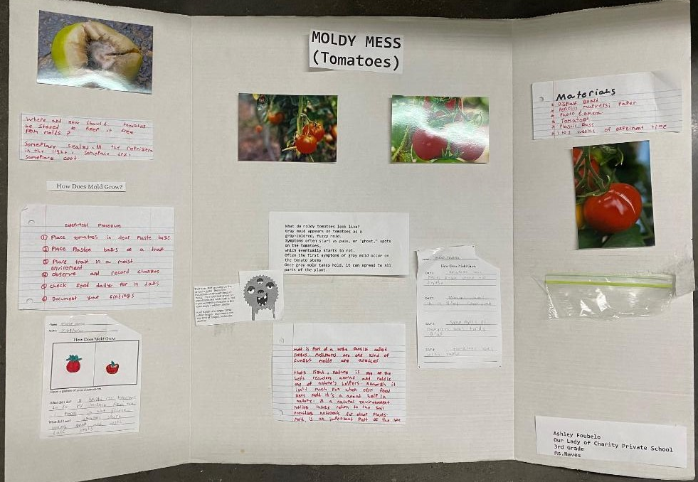
Ashley Foubelo

Slide 20
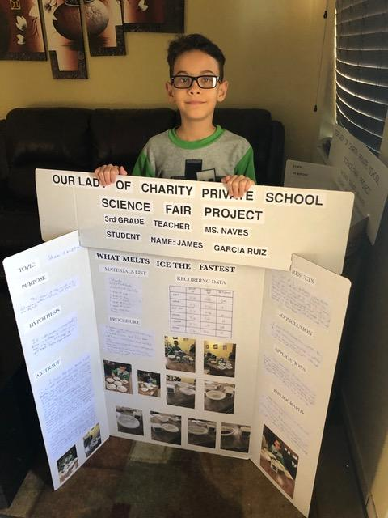
James Garcia Ruiz

Slide 21
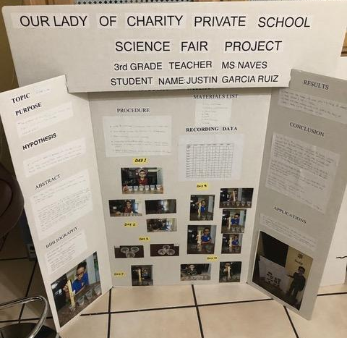
Justin
Garcia
Ruiz

Slide 22
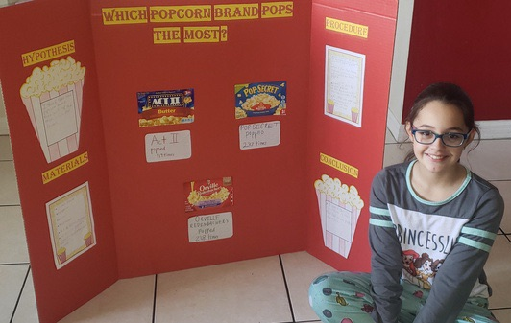
Yessena Guerra

Slide 23
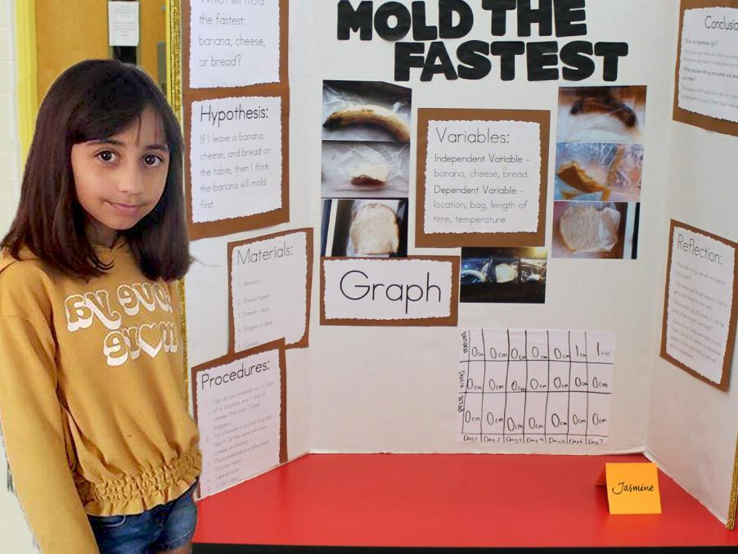
Jasmin Hidalgo

Slide 24
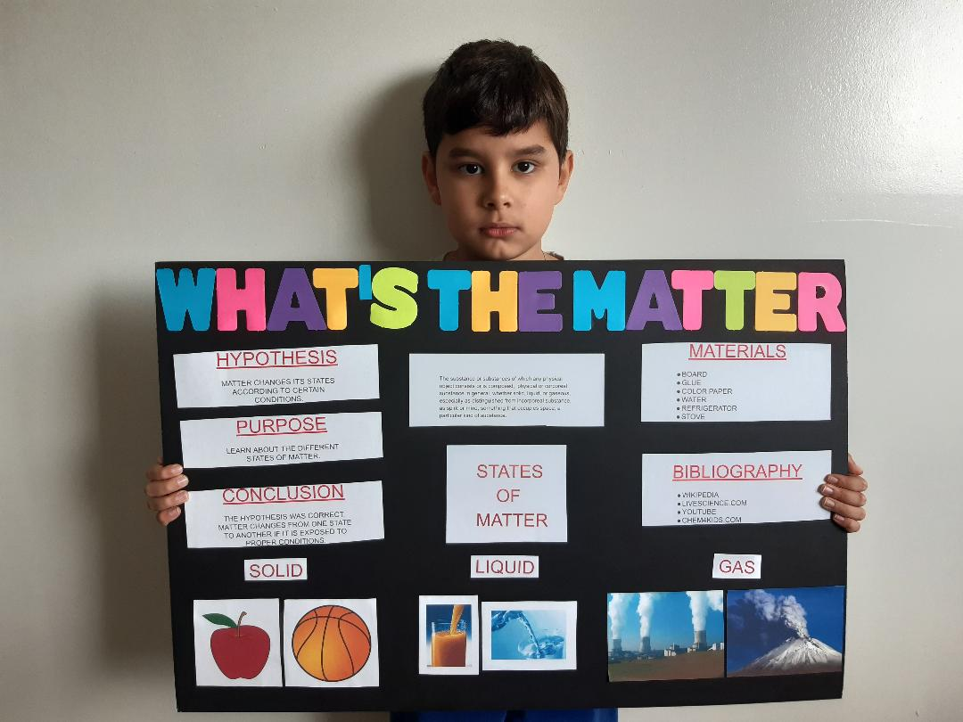
Angelo Lazo

Slide 25
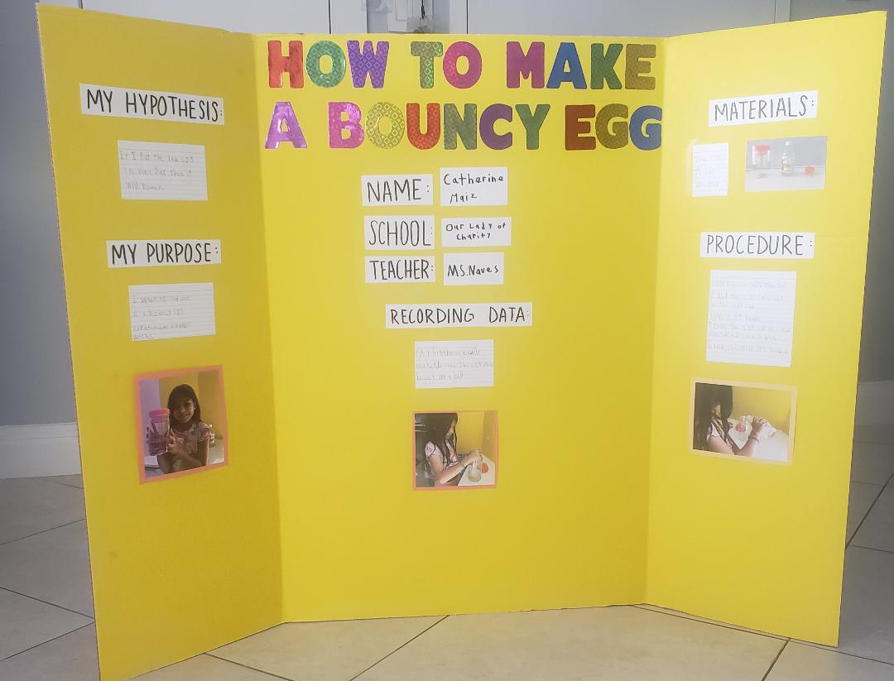
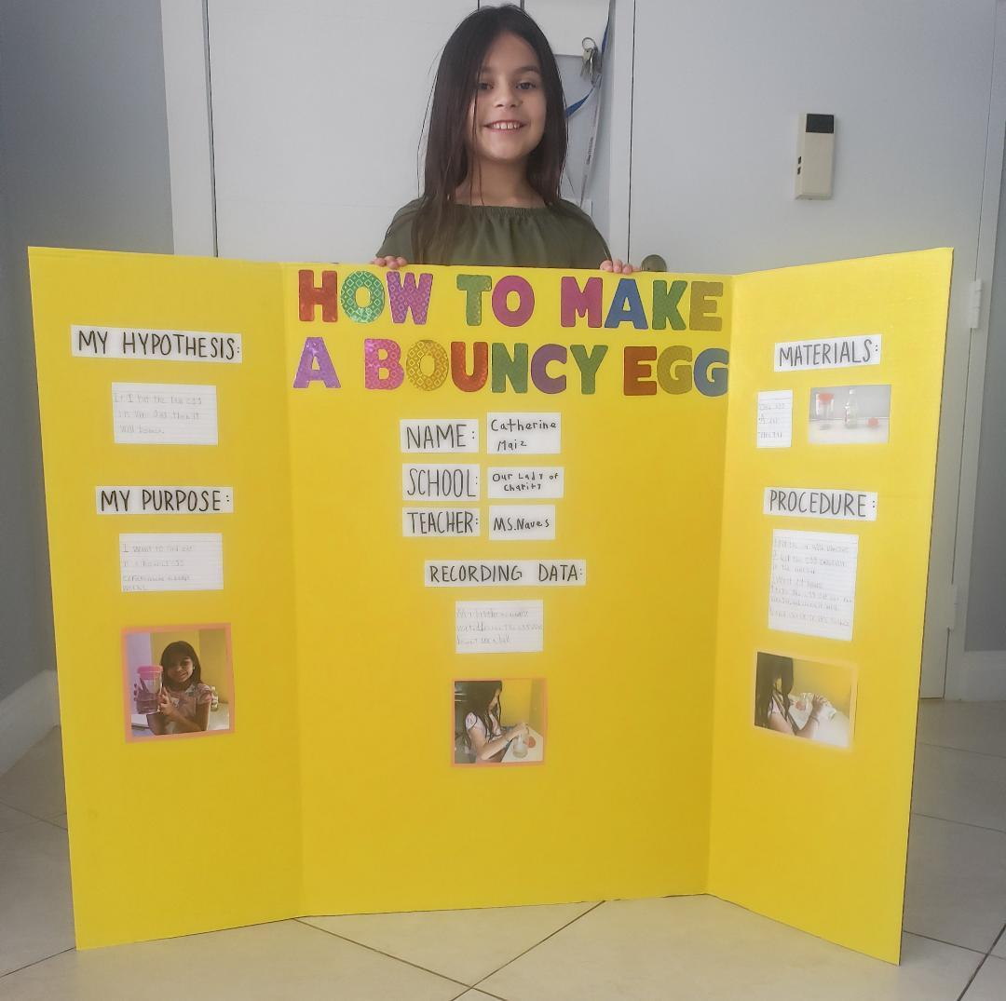
Catherine Maiz

Slide 26
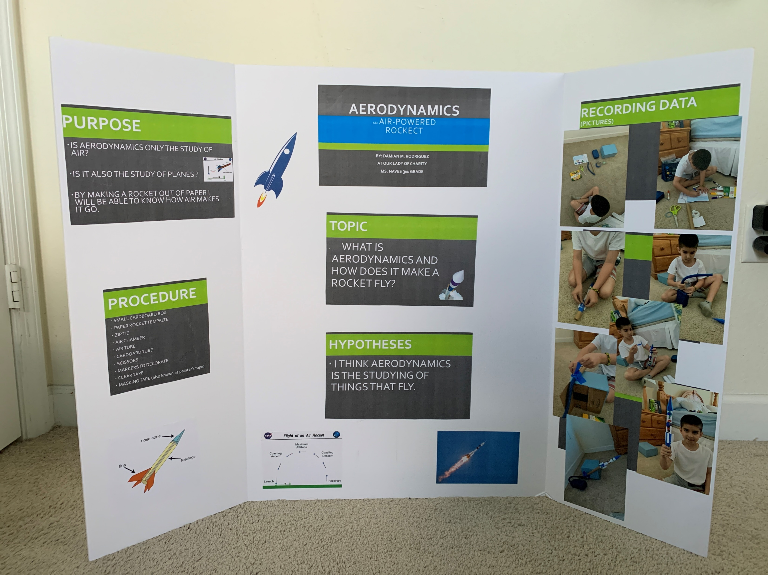
Damian Rodriguez

Slide 27
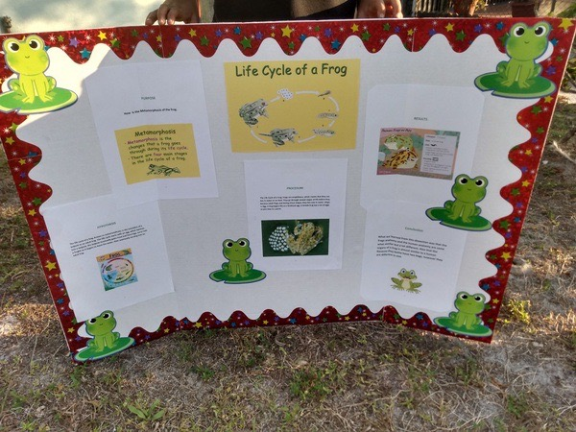
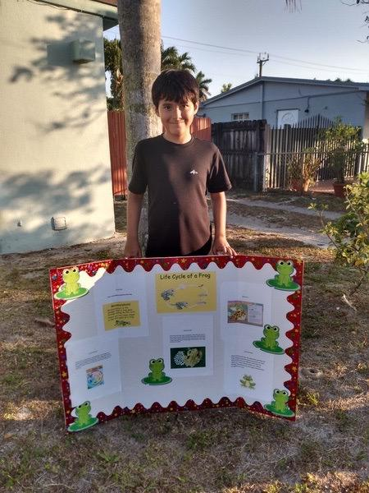
Eduardo Suarez

Slide 28
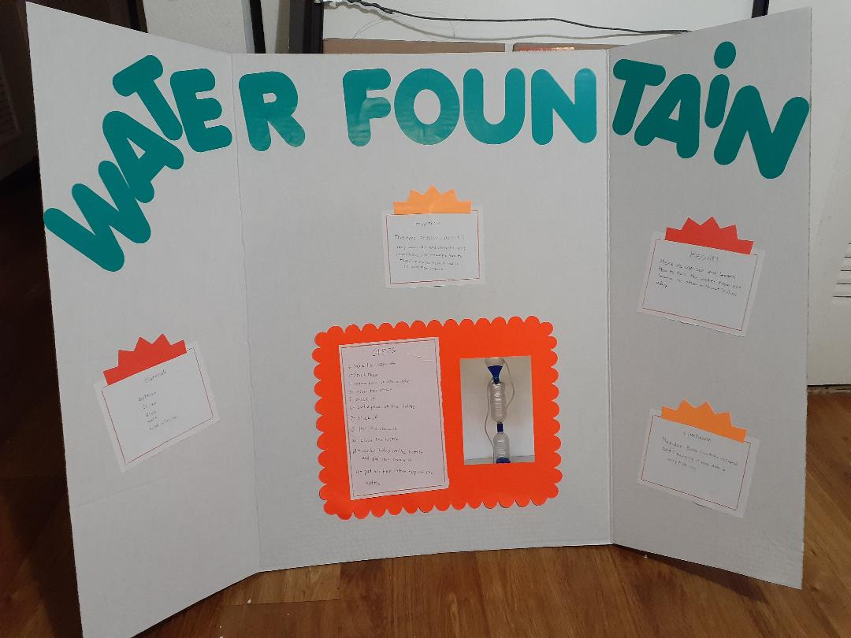
Gerard Valdez

Slide 29
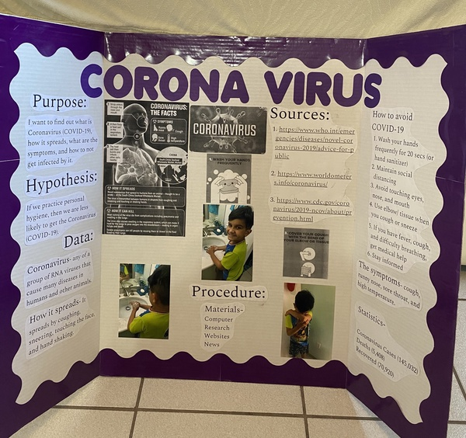
Austin Vega

Slide 30

Science Fair
2019 - 2020
Fourth Grade

Slide 31
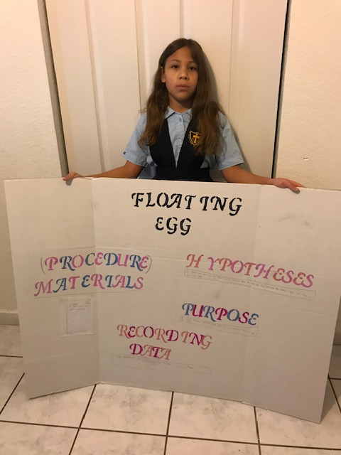
Danielle Alvarez

Slide 32
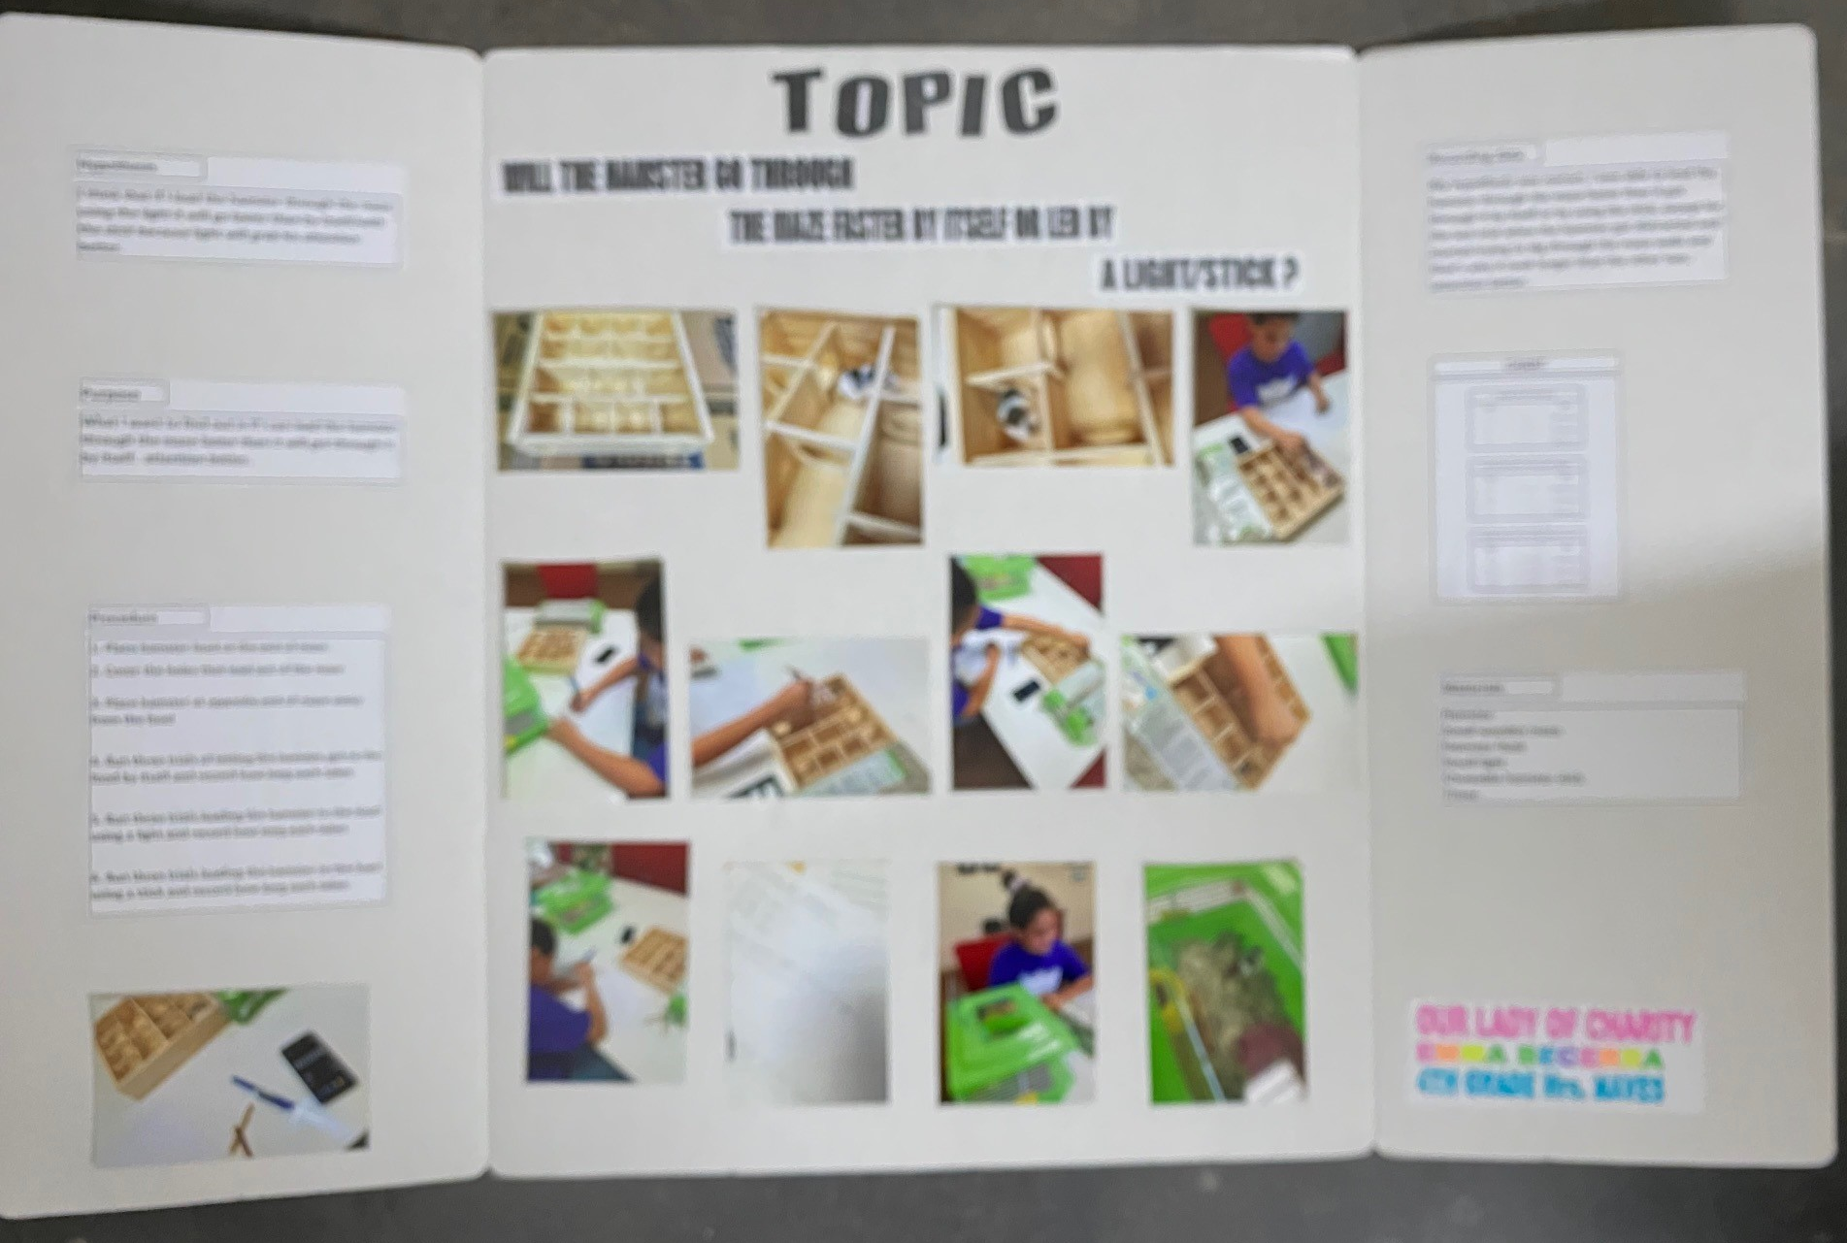
Emma
Becerra

Slide 33
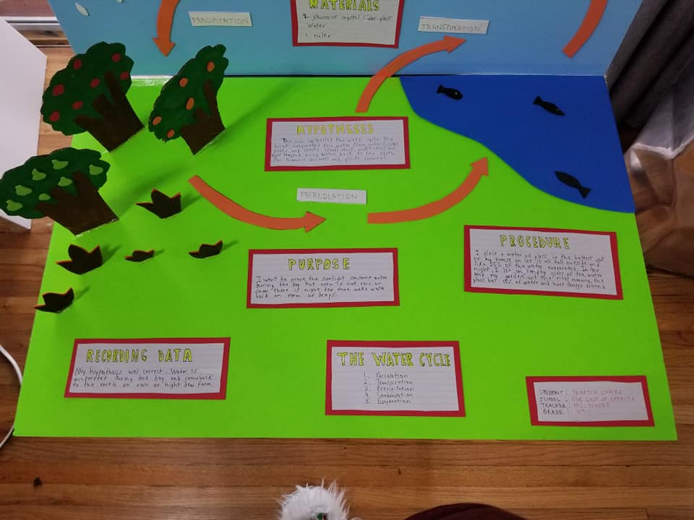
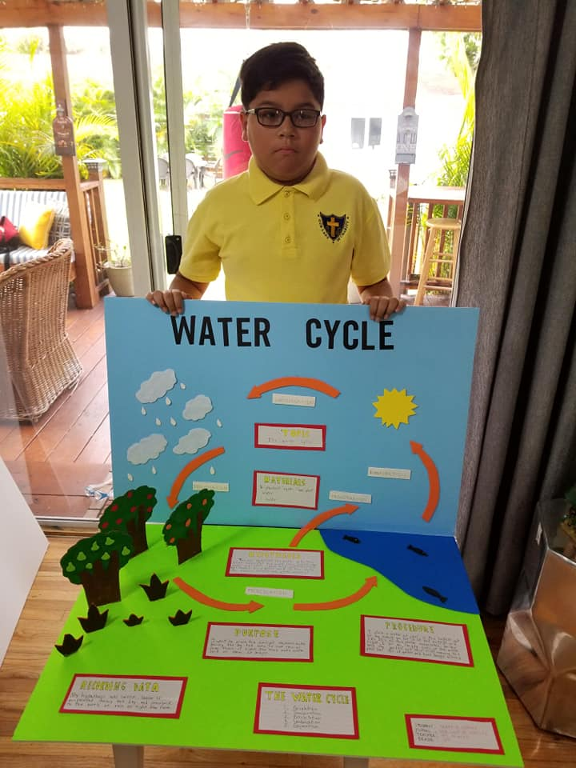
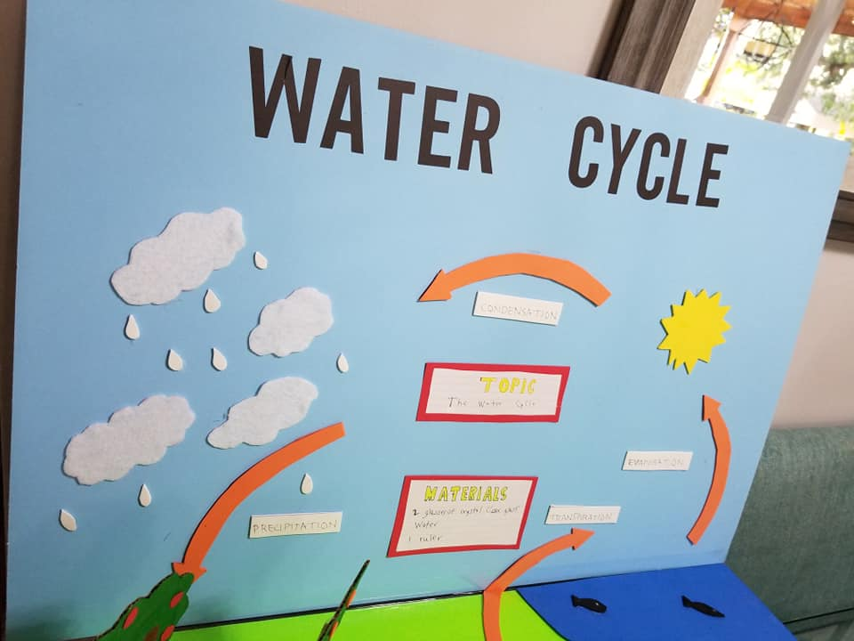
Martin Chavez

Slide 34
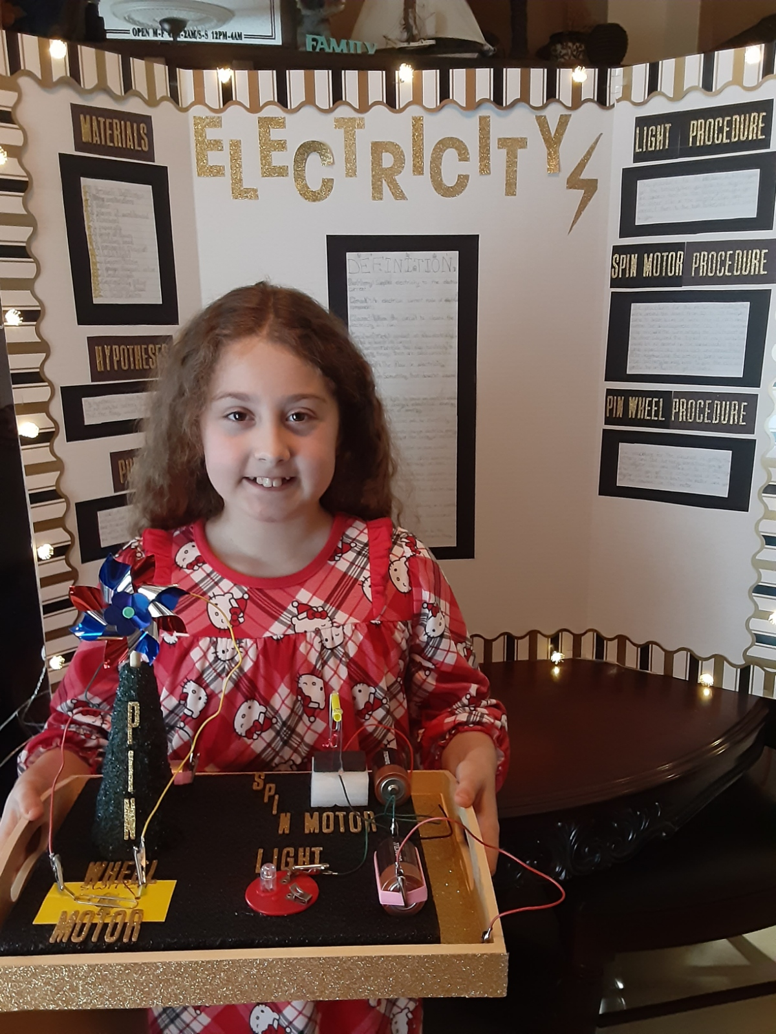
Alexa
Gonzalez

Slide 35
Yaiza Hernandez

Slide 36
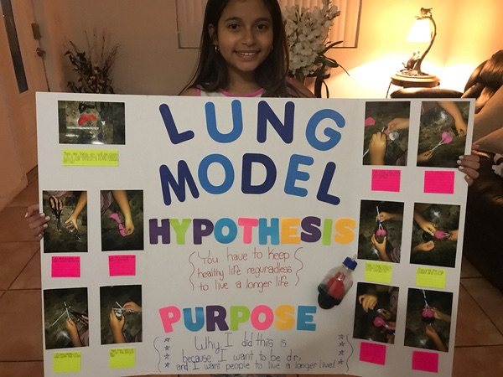
Melanie
Paulino

Slide 37
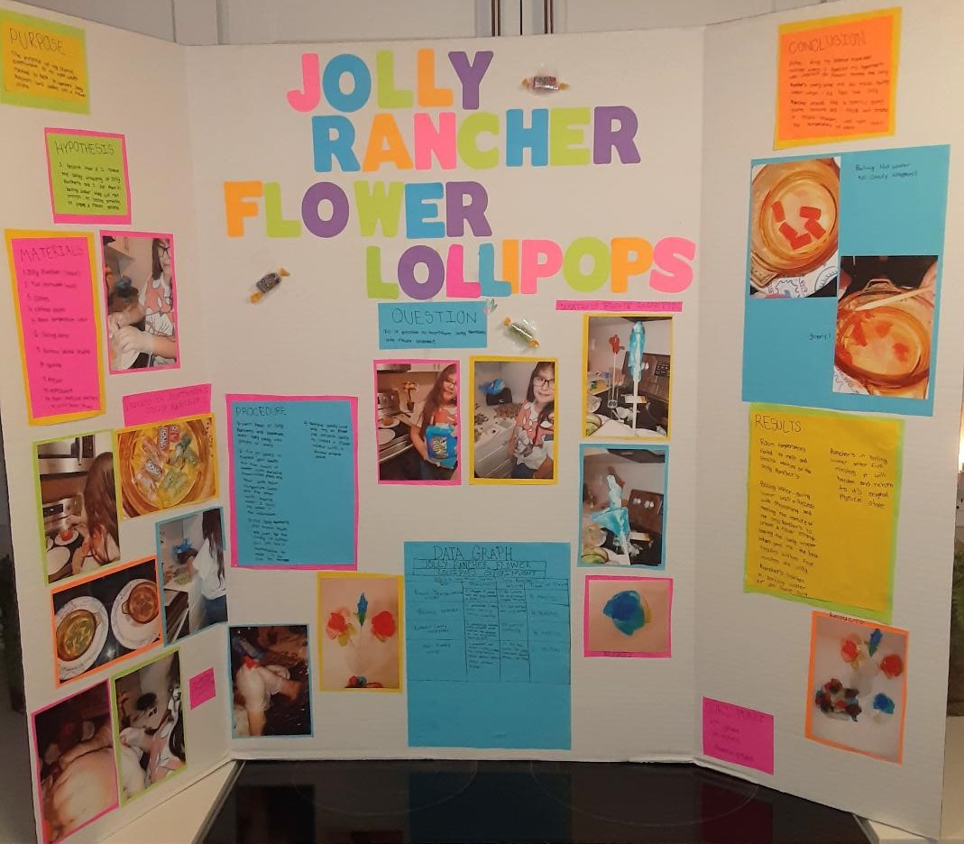
Suri
Perez

