Slide 1

Science Projects
2019-2020
Kindergarten & First Grade

Slide 2
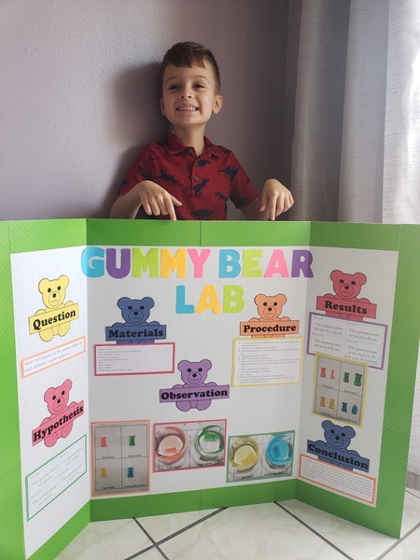
Fernando Gonzalez

Slide 3
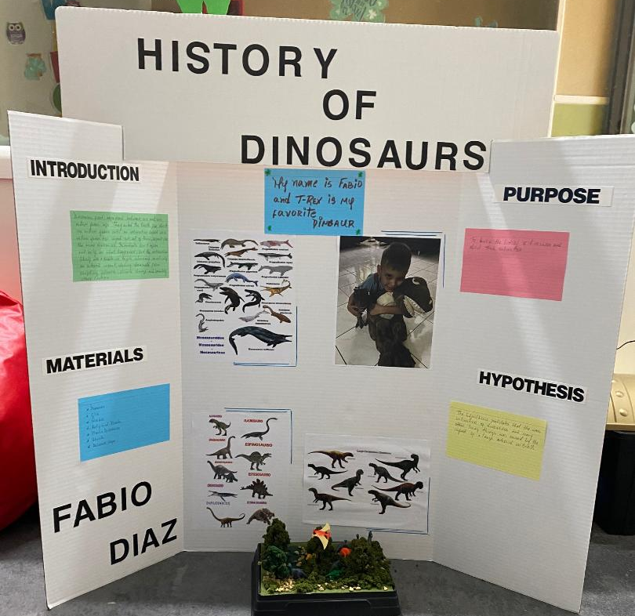
Fabio Diaz

Slide 4
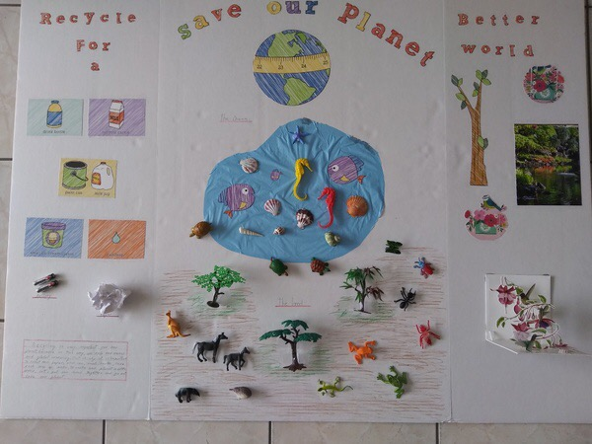
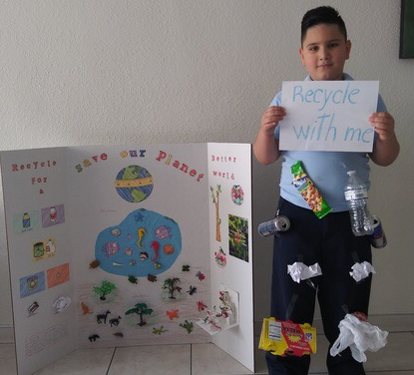
Sandro Napoles

Slide 5
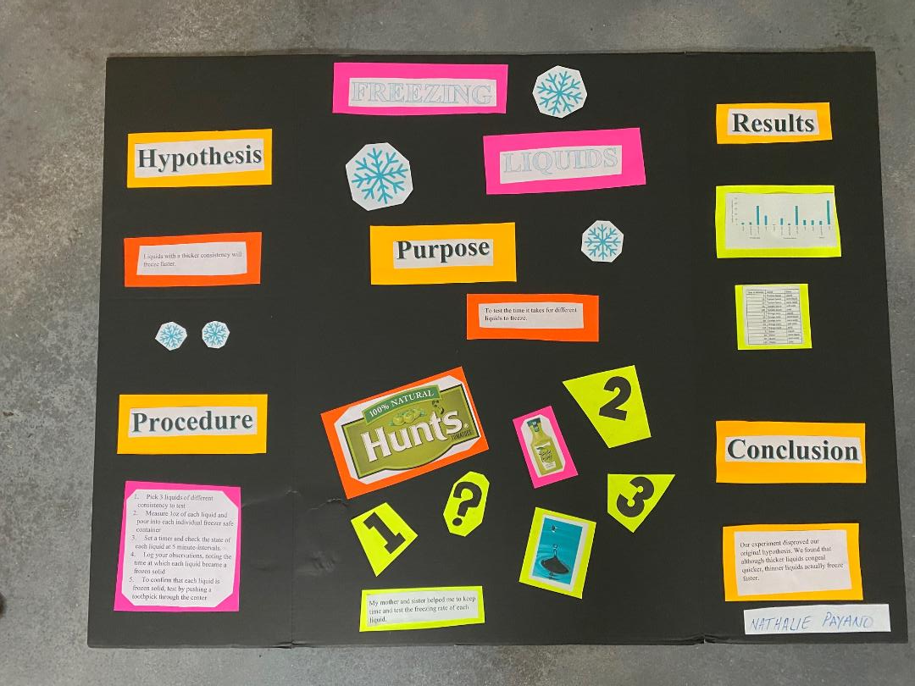
Nathalie Payano

Slide 6
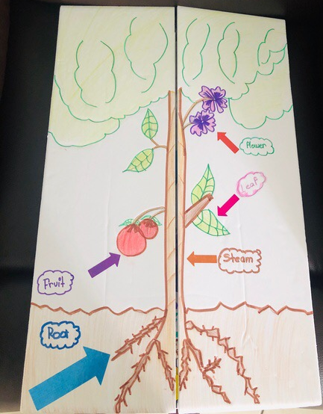
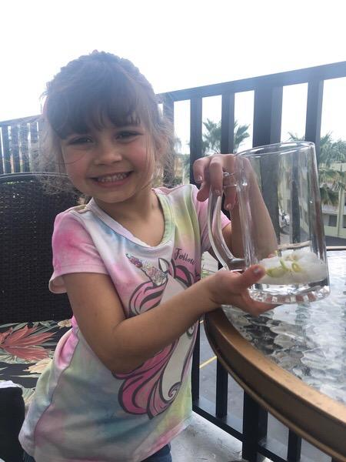
Nashley Valdespino

Slide 7
First Grade

Slide 8
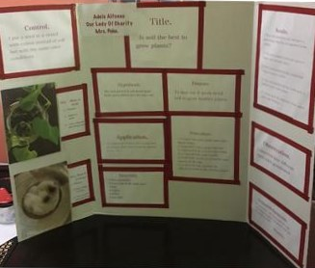
Adele ALfonso

Slide 9
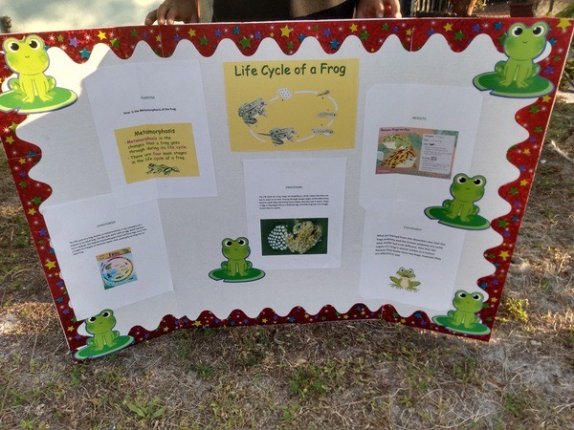
Jade Diaz

Slide 10
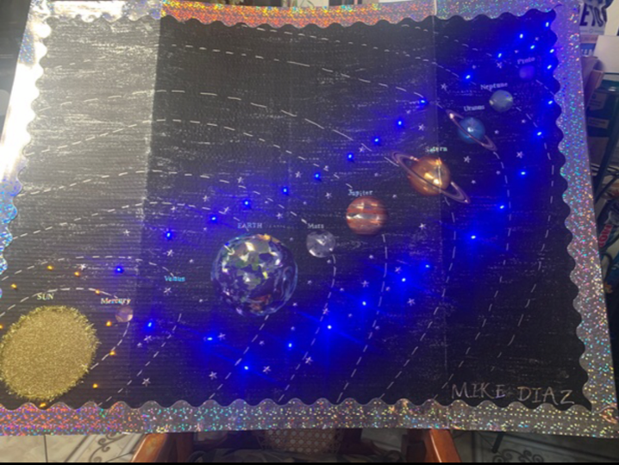
Mike Diaz

Slide 11
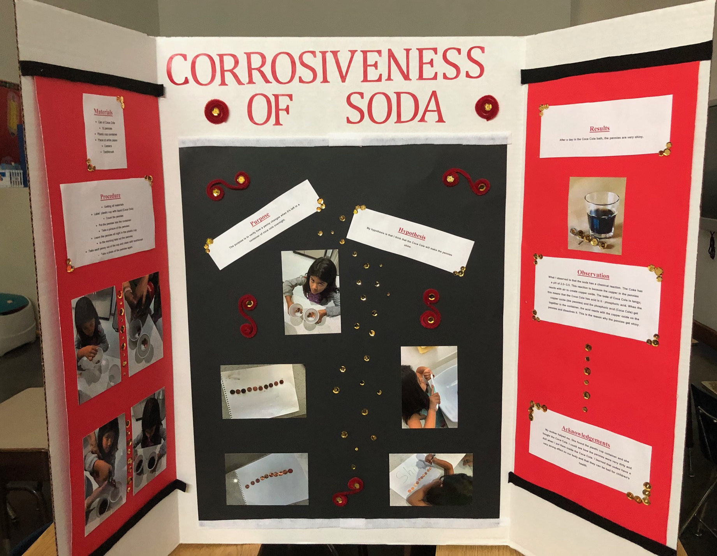
Galilea Gaitan

Slide 12
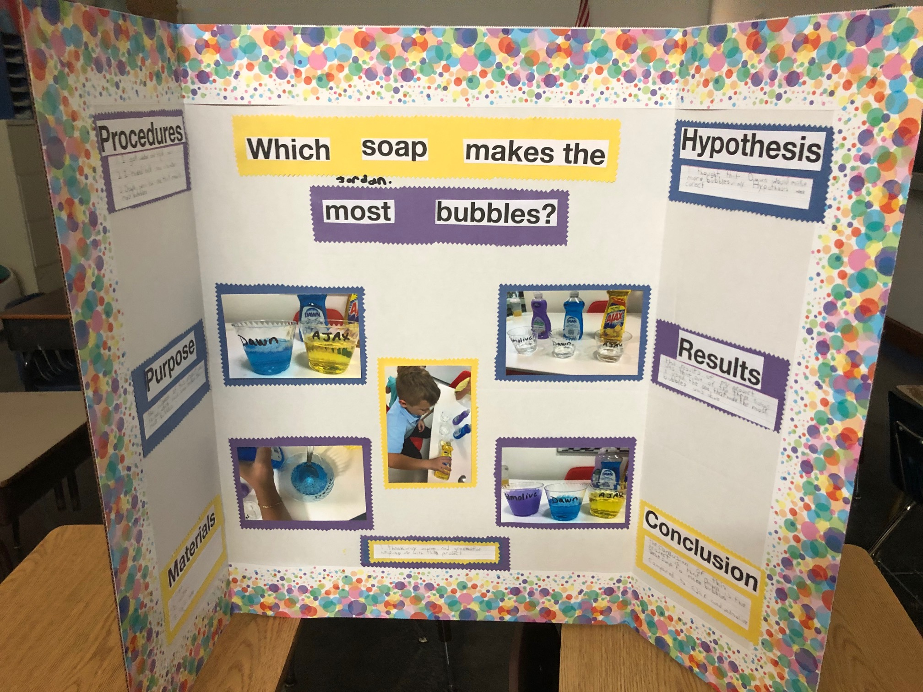
Jordan Garcia

Slide 13
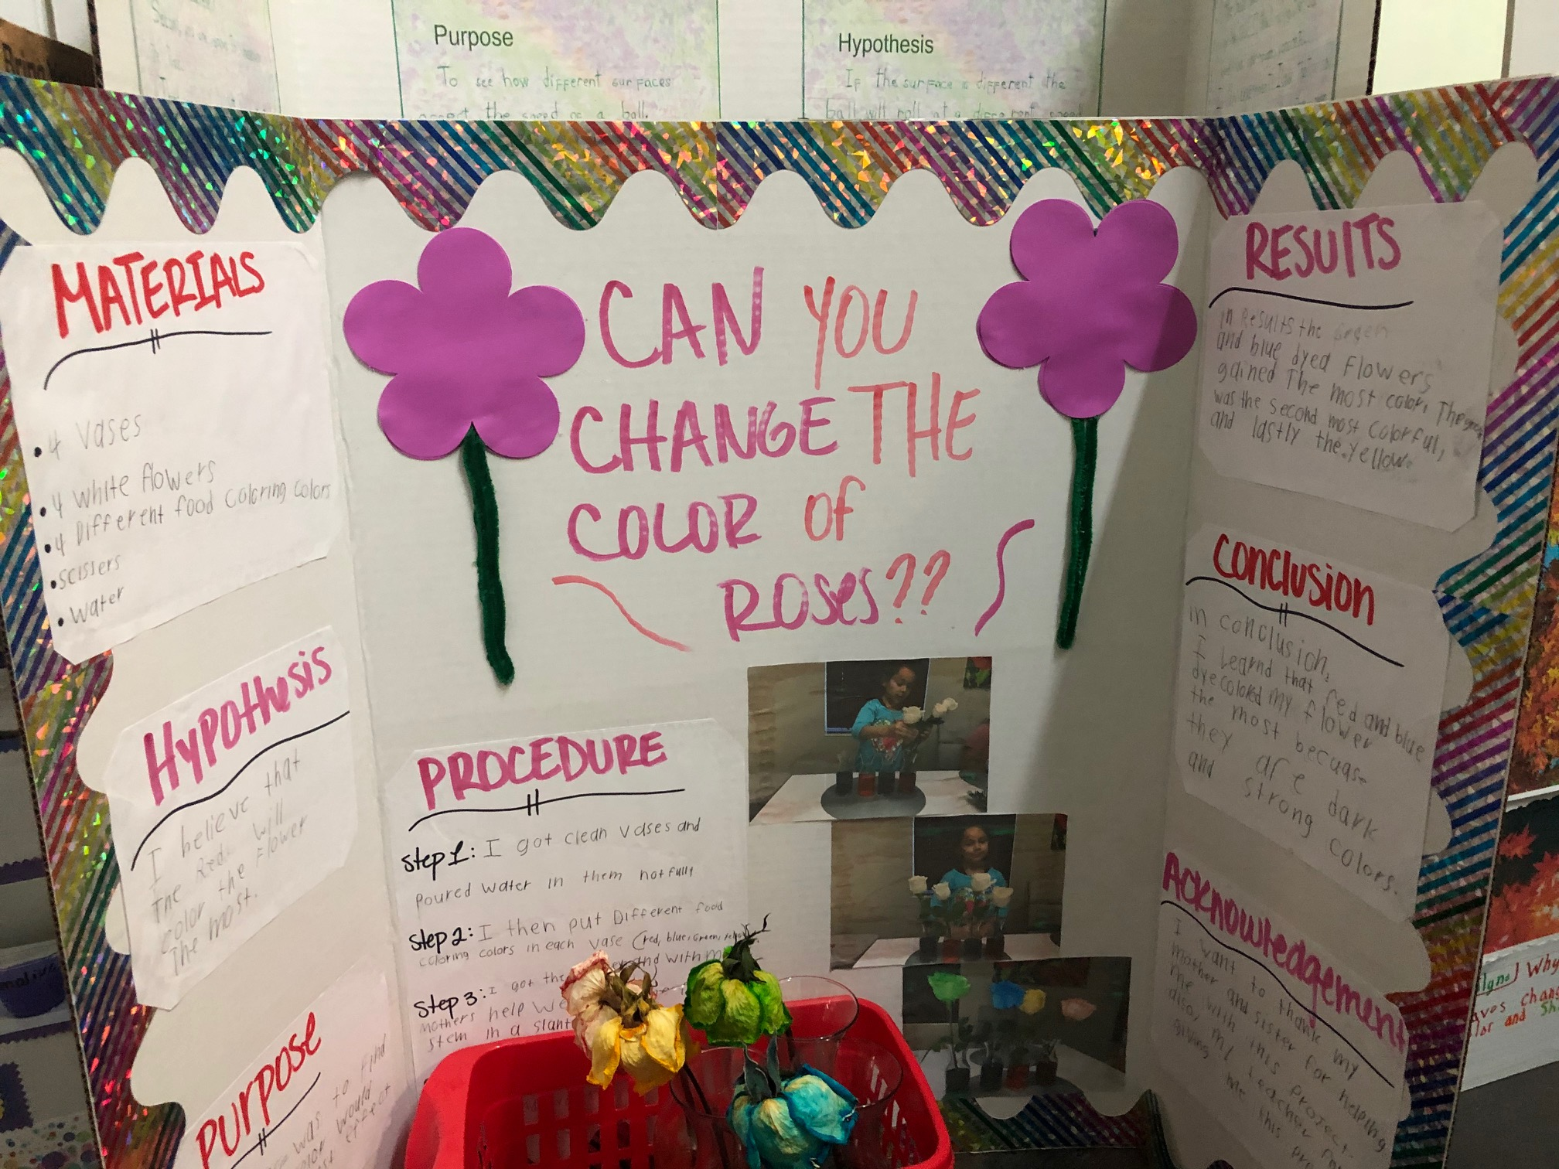
Abrianna Hernandez

Slide 14
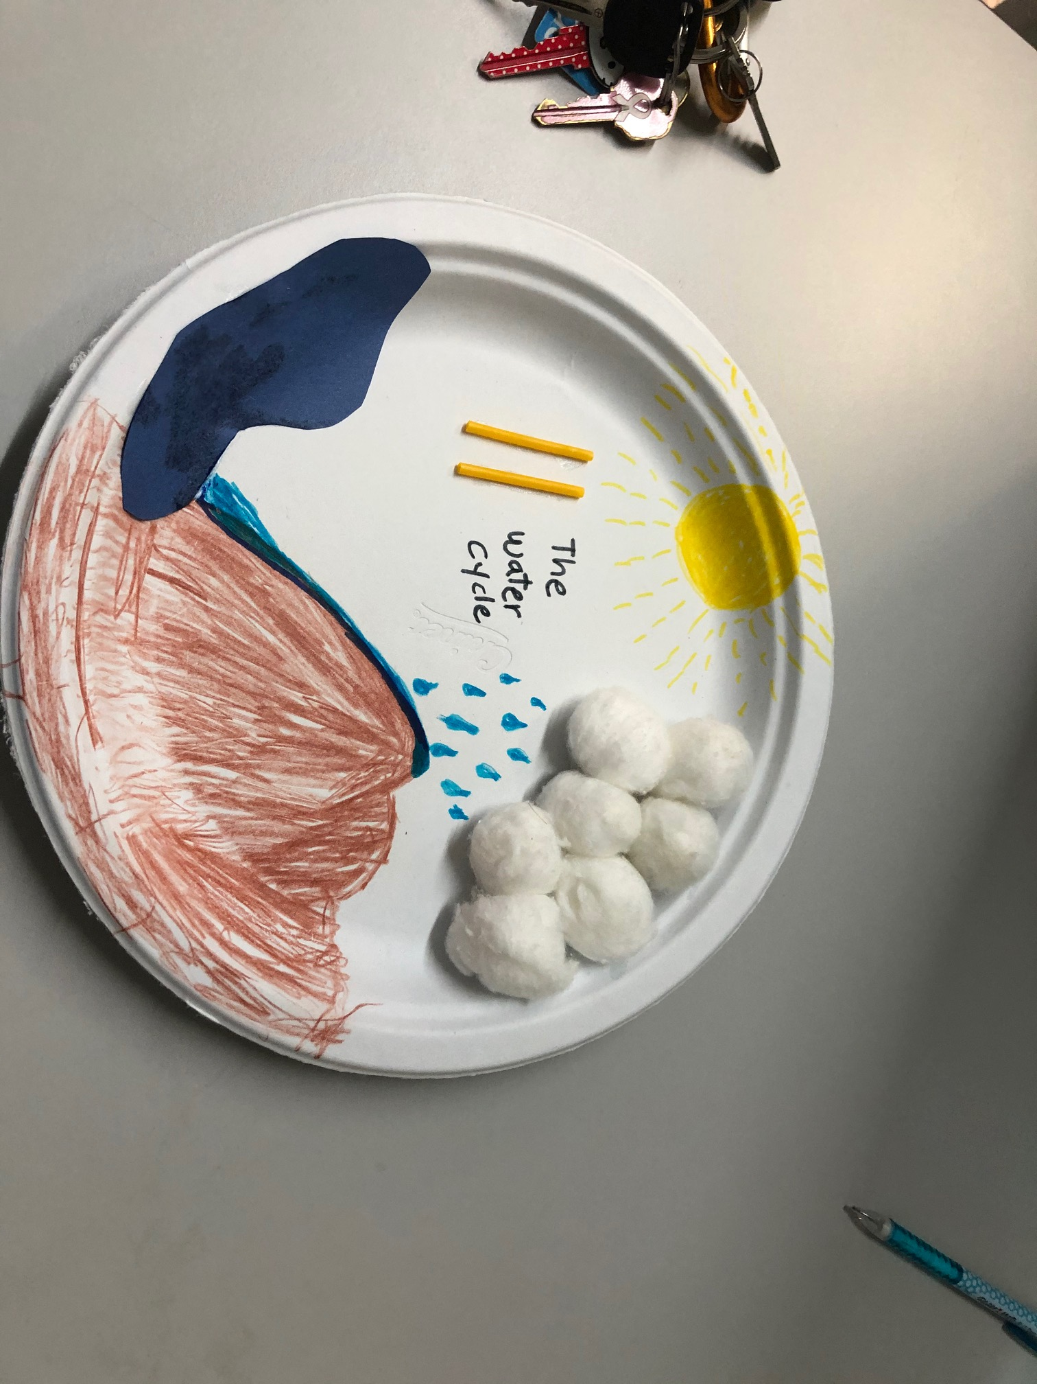
Victor Reyes

Slide 15
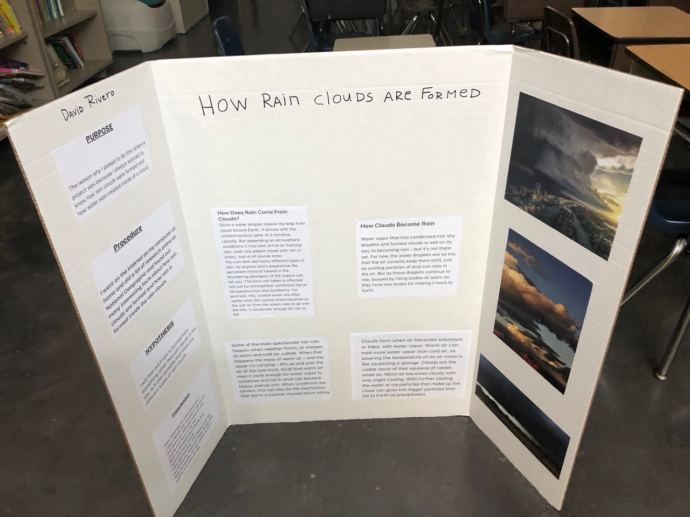
David Rivero

Slide 16
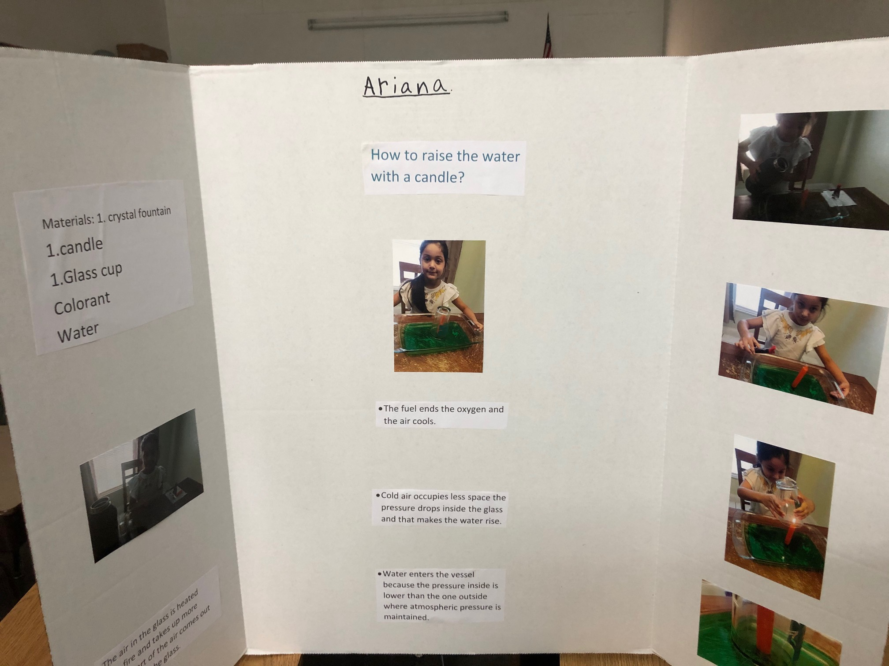
Ariana Rodriguez

